Slide 1
Course: Artificial Intelligence Principle
Prof. Xiaodan Liang
中山大学智能工程学院

Slide 2
Motivations
主要讲述人工智能中的核心概念、方法和技术。目的是使学生能够建立起对于人工智能的总体认识，为以后进入人工智能各分支的学习和研究奠定基础。
1. 学习符号式人工智能的基本思想，重点掌握问题求解方法，搜索技术，知识表示方法，和经典逻辑推理方法。
2. 学习连接主义的基本思想，重点掌握人工神经网络的各种拓扑结构及其学习算法。
3. 学习机器学习的概念和主要方法，重点在于监督学习和非监督学习的一些主流方法。
4. 学习规划、不确定知识与推理的基本思想和主要方法。主要内容包括概率和贝叶斯网络。
5. 培养应用人工智能思想、方法与技术解决问题的能力和一定的创新能力(一般掌握)。
6. 人工智能的最新进展(一般了解)。

Slide 3
Motivations
教学环节安排
(对各种教学环节的安排如：实验、实习、习题课、作业等以及本课程与其他相关课程的联系、分工等作必要说明)
课堂讲授：全程采用多媒体教学手段。
实验环节：本课程有专门的配套实验课，实验课程的具体要求见 人工智能实验 课程。
作业：每周1~2题。
教学方法
(包括课堂讲授、提问研讨，课后习题和答疑等情况)
教学方法主要包括多媒体课堂教学，课堂提问，期中研讨，课后作业和答疑等方法。

Slide 4
Motivations
参考教材
[1] Artificial Intelligence: A Modern Approach, by S. Russell and P. Norvig, 3rd Edition, Prentice Hall, 2009.
[2] Deep Learning for Human Centric Visual Analysis, Liang Lin, Dongyu Zhang, et al., Springer, 2018.
[3] 前沿学术论文
成绩评定方式
考核：采用日常性考核和期末终结性考核相结合的方式。
成绩评定：实验课及课堂表现占40%，期末大作业成绩占60％，按百分制给出最终成绩。

Slide 5
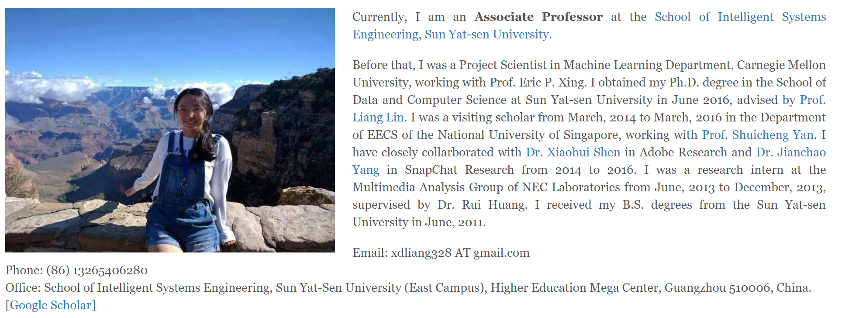

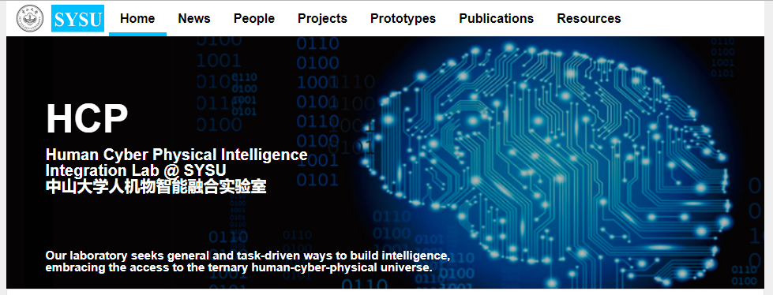
Instructors
助教：
罗琨皓
冯大鹏
http://www.sysu-hcp.net

Slide 6
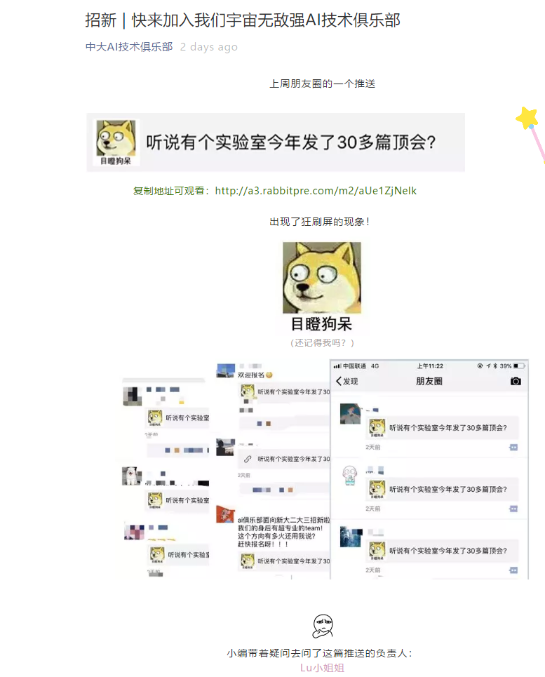



Instructors

Slide 7
Outline
What is AI?
The history of AI
Applications of AI
Current status of AI
The basic content of AI research
Cognitive modeling
Knowledge representation
Automatic reasoning
Machine learning
Future of AI

Slide 8
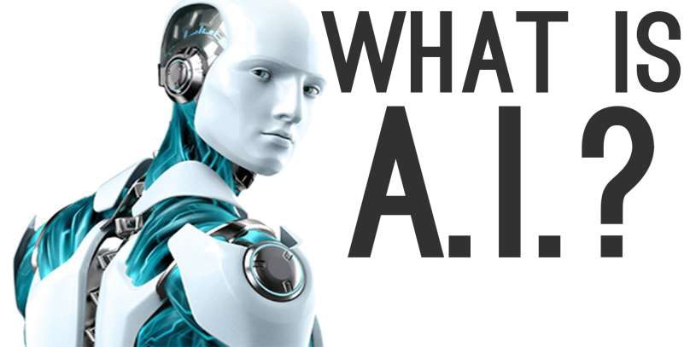
What is AI?
The study of computer systems that attempt to model and apply the intelligence of the human mind.
A branch of computer science dealing with the simulation of intelligent behavior in computers.
The capability of a machine to imitate intelligent human behavior.

Slide 9
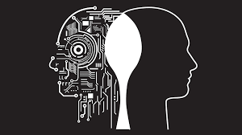
What’s intelligence?
Intelligence: Among the traits that researchers hope machines will exhibit are perception,reasoning, knowledge, planning, learning, communication, and the ability to rationally move and to manipulate objects.
AI tries to understand and model intelligence as a
computational process

Slide 10
Strong AI versus weak AI
Strong AI: a machine with a mind in exactly the same sense human beings have minds
Weak AI: a machine with intelligent behavior
Artificial general intelligence (AGI): a machine with the ability to apply intelligence to any problem
Narrow AI: AI focused on one narrow task All currently existing AI systems are weak AI at most

Slide 11
Outline
What is AI?
The history of AI
Applications of AI
Current status of AI
The basic content of AI research
Cognitive modeling
Knowledge representation
Automatic reasoning
Machine learning
Future of AI

Slide 12
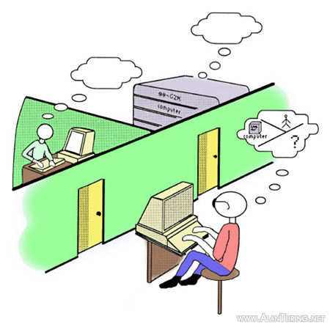
History of AI
1943-70: Early excitement, great expectation
1943: Originated, McCullouch and Pitts’ design for Turing-complete “artificial neurons”. Formed the structural AI.
1950: Turing Test, proposed by A.M. Turing in 1950.
A human interrogator asks questions by typing
Answers are displayed on a screen.
The computer passes the test if the
interrogator cannot reliably decide
computer / person.

Slide 13
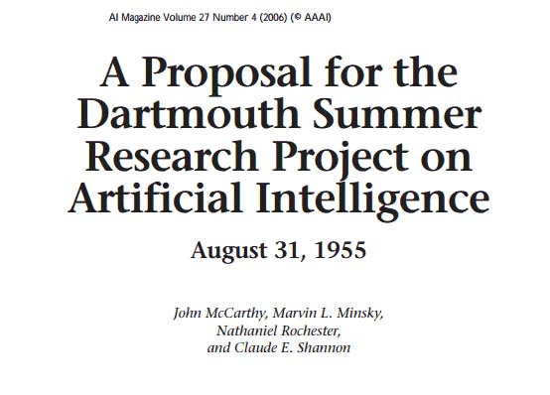
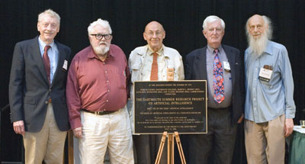
History of AI
1955: Newell & Simon wrote a reasoning program: Logic Theorist, proved theorems from Principia Mathematica.
1956: The field of AI research was born at workshop at Dartmouth College.
1965: Robinson's complete algorithm for logical reasoning.

Slide 14
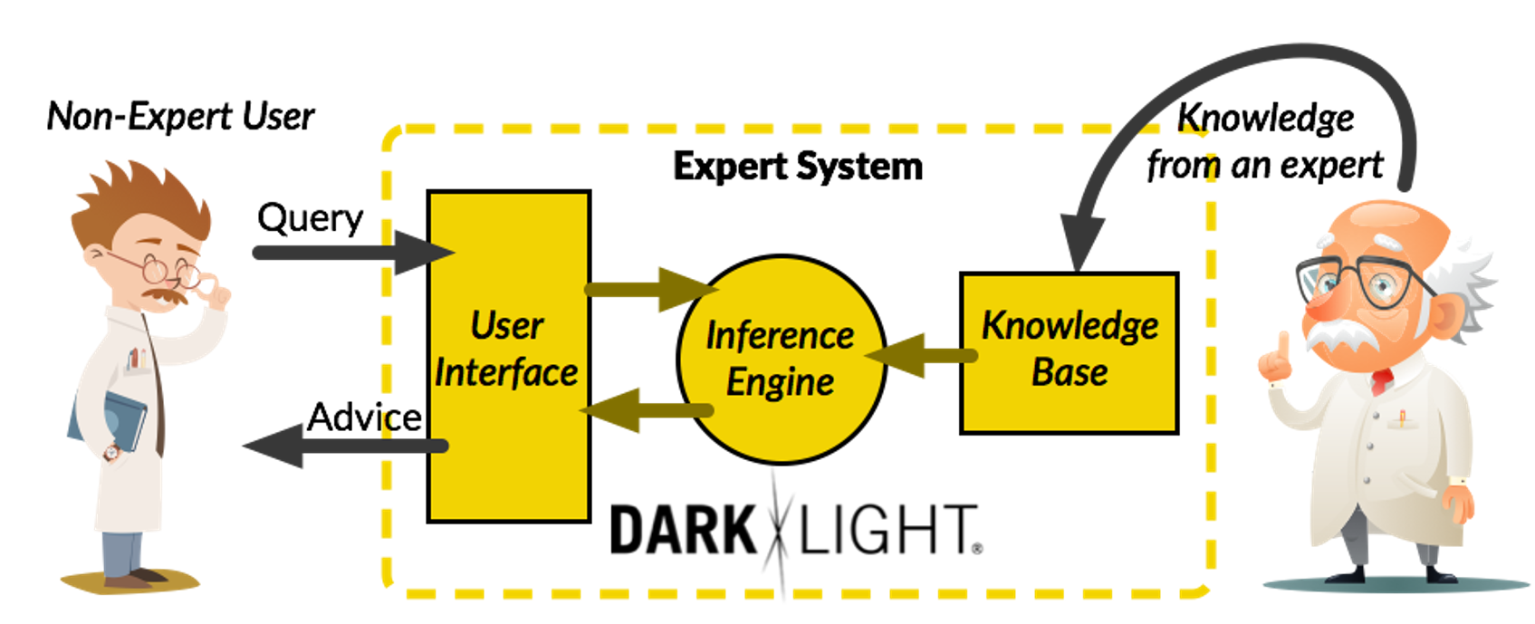
History of AI
1970-90s: “Knowledge is power”: knowledge-based
approaches
1974-80: So many difficulties that progress slowed, governments cut off exploratory research in AI —— AI “Winter”
1980-87: Expert systems industry booms
1987-93: The Fifth-Generation Computer System (Japan) Project failed —— AI’s longer-lasting hiatus.

Slide 15

History of AI
1990- : rise of machine learning ——“AI Spring”
“Knowledge” is learnt by computers primarily
Supervised learning, classification, regression …
Unsupervised learning, association rule learning ,clustering …
Deep learning, artificial neural networks …
2010s : heavy industry investment in deep learning

Slide 16
Outline
What is AI?
The history of AI
Applications of AI
Current status of AI
The basic content of AI research
Cognitive modeling
Knowledge representation
Automatic reasoning
Machine learning
Future of AI

Slide 17
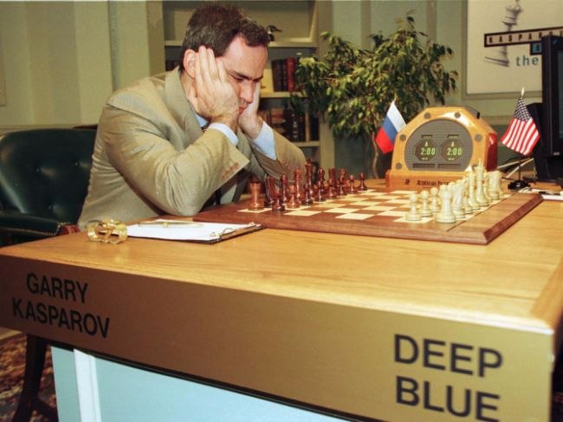
Deep Blue (1997)
In 1997, IBM's Deep Blue chess computer defeated world chess champion Garry Kasparov

Slide 18
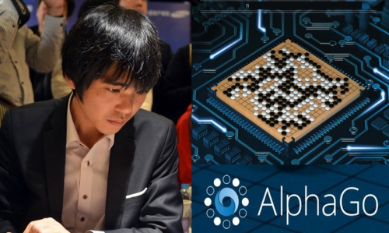
AlphaGo (2016)
In 2016, Google DeepMind's AlphaGo program defeated (4-1) Lee Sedol, a 9-dan professional

Slide 19
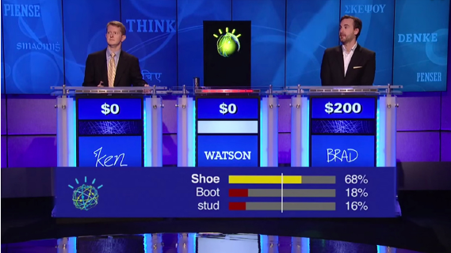
IBM Watson (2011)
In 2011, IBM Watson defeated two of the biggest winners (Brad Rutter and Ken Jennings) at the quiz show Jeopardy!

Slide 20
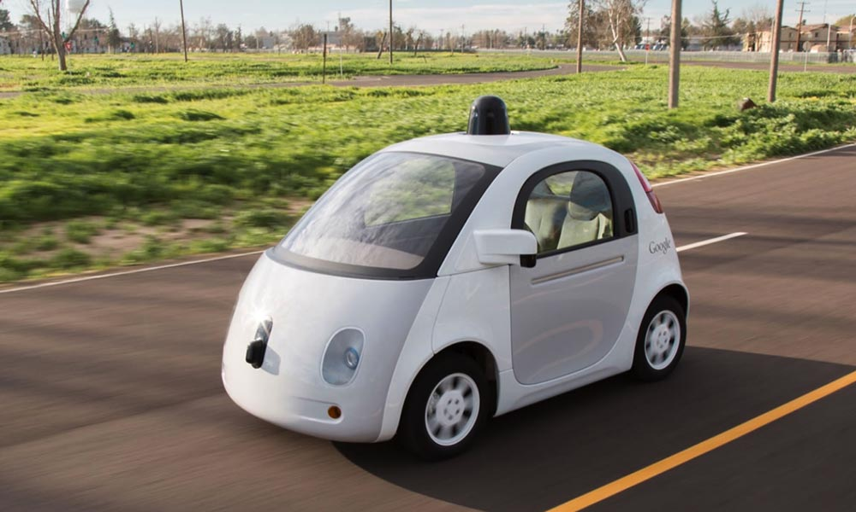
Autonomous driving
The DARPA Grand Challenge: a prize competition for driverless cars: Stanford won in 2005, CMU in 2007
In 2009, Google started a self-driving car program, and since then, their self-driving cars have driven over 1 million miles

Slide 21
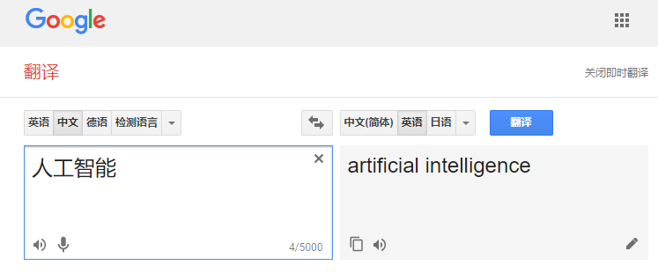
Machine translation
As of 2017, Google Translate supports over 100 languages and serves over 500 million people daily.

Slide 22
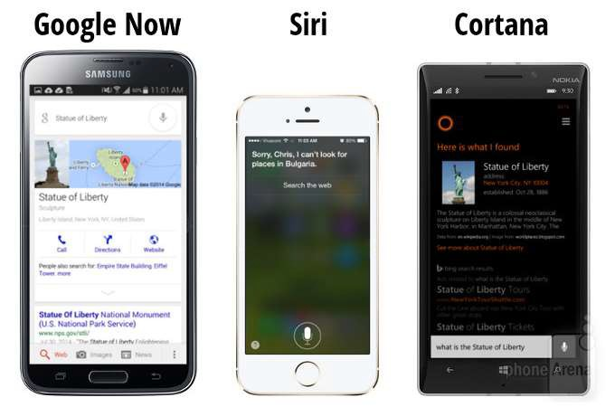
Virtual assistants
They can help find useful information when people ask for it using their voice.

Slide 23


Microsoft Xiaobice
The system learns about the user and provides natural language conversation and some AI service.

Slide 24
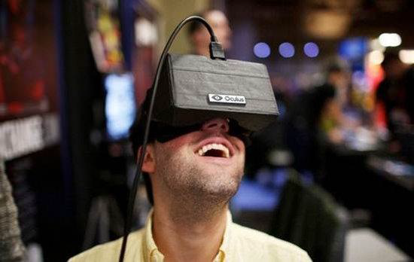
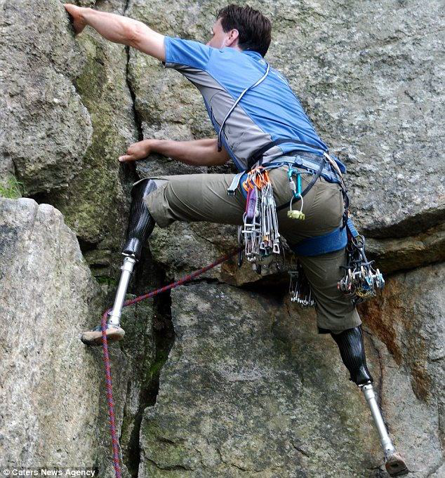
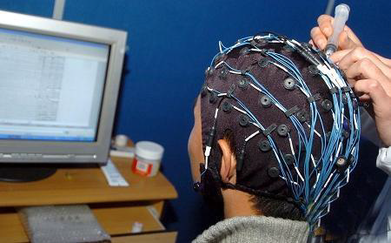
Human-Computer Interaction
Substitute some functions of human, make human better

Slide 25
Current status of AI
Many people seem to think artificial intelligence is leading us toward some kind of roboapocalypse or a dreamscape techno-utopia.
I don’t believe we’ll be in either scenario anytime soon. But in between those extreme views lie all the real-world ways AI already enhances our lives.
For example:
AI has blessed us by catching 99.9% of Gmail spam in our inboxes for years now.
A pilot project with smart traffic lights powered by AI is reducing vehicle wait time by 40%.
As more and more industries experiment with AI, its impact on our day-to-day lives will continue to grow.

Slide 26
Outline
What is AI?
The history of AI
Applications of AI
Current status of AI
The basic content of AI research
Cognitive modeling
Knowledge representation
Automatic reasoning
Machine learning
Future of AI

Slide 27
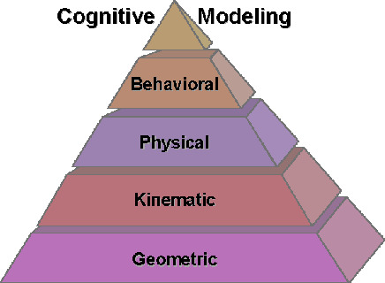
Cognitive modeling
What’s cognitive modeling: Cognitive modeling deals with simulating human problem-solving and mental processing in a computerized model.
Such a model can be used to simulate or predict human behavior or performance on tasks similar to the ones modeled and improve human-computer interaction.

Slide 28
Cognitive models
An important goal of cognitive science is to understand human cognition.
Good models of cognition can be predictive — describing how people are likely to react in different scenarios — as well as prescriptive — describing limitations in cognition and potentially ways in which the limitations might be overcome.
In a sense, the benefits of having cognitive models are similar to the benefits individuals accrue in building their own internal model.

Slide 29
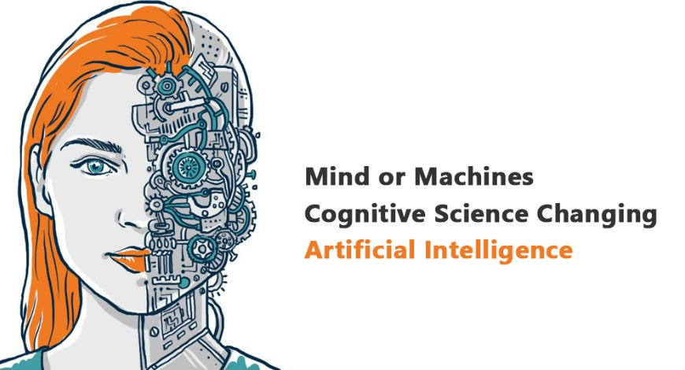
Cognitive modeling
The problem in early models followed logical processes that humans don't always adhere to, and they failed to take into account variables that affect human cognition, such as fatigue, emotion, stress and distraction.
That is what cognitive modeling concern.

Slide 30
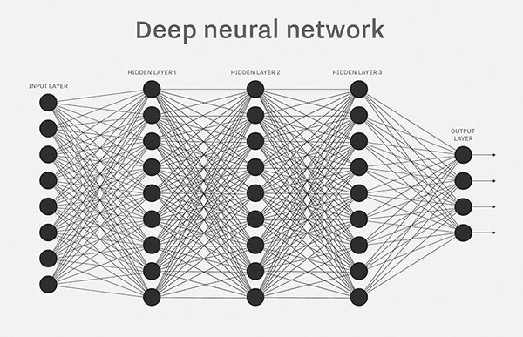
Types of cognitive model
Neural network
Neural networks work similarly to the human brain by running training data through a large number of computational nodes, called artificial neurons, which pass information back and forth between each other. By accumulating information in this distributed way, applications can make predictions about future inputs.
In a neural network, data passes back and forth between many neurons.

Slide 31
Types of cognitive model
Reinforcement learning
This approach has algorithms run through many iterations of a task that takes multiple steps, incentivizing actions that eventually produce positive outcomes, while penalizing actions that lead to negative ones.
This is a primary part of the AI algorithm that Google's DeepMind used for its AlphaGo application, which bested the top human Go players in 2016.
These models can also be used in natural language processing and smart assistant applications, have improved human-computer interaction, making it possible for machines to have rudimentary conversations with humans.

Slide 32
Potential limitations
Despite advancements in applying cognitive models to artificial intelligence, it still falls short of its true goal of simulating human thinking.
This is very different from how human brains work. The human brain uses a combination of context and more limited experience to make generalizations about new experiences, something even the most advanced cognitive models can't do today.
The most advanced biological research into the human brain still lacks a complete picture of how it works. Even if that baseline information is established, transposing human thought processes onto computer programs is another leap entirely.

Slide 33
Outline
What is AI?
The history of AI
Applications of AI
Current status of AI
The basic content of AI research
Cognitive modeling
Knowledge representation
Automatic reasoning
Machine learning
Future of AI

Slide 34
Knowledge representation
Knowledge representation (KR) is the field of artificial intelligence (AI) dedicated to representing information about the world in a form that a computer system can utilize to solve complex tasks such as diagnosing a medical condition or having a dialog in a natural language.
Knowledge representation incorporates findings from psychology about how humans solve problems and represent knowledge in order to design formalisms that will make complex systems easier to design and build.
Knowledge representation and reasoning also incorporates findings from logic to automate various kinds of reasoning, such as the application of rules or the relations of sets and subsets.

Slide 35
Examples
Examples of knowledge representation formalisms include:
Semantic nets
Systems architecture
Frames
Rules
Ontologies

Slide 36
Outline
What is AI?
The history of AI
Applications of AI
Current status of AI
The basic content of AI research
Cognitive modeling
Knowledge representation
Automatic reasoning
Machine learning
Future of AI

Slide 37
Automatic reasoning
Automatic reasoning is arguably the earliest application area of Artificial Intelligence.
Throughout the history of AI, automatic reasoning has played an important role.
Its products include a large number of inferencing techniques and strategies.
It uses deductive reasoning to tackle problems.
Such as:
Constructing formal mathematical proofs;
Verifying that programs meet their specifications;
Modelling human reasoning.

Slide 38
Automatic reasoning
Tools and techniques of automated reasoning include:
Classical logics and calculi
Fuzzy logic
Bayesian inference
Reasoning with maximal entropy
Proof systems
Boyer-Moore Theorem Prover (NQTHM): Started in 1971,this was a fully automatic theorem prover built using Pure Lisp.
HOL Light: Designed to have a simple and clean logical foundation and an uncluttered implementation. It is essentially another proof assistant for classical higher order logic.
Coq: Coq is another automated proof assistant, which can automatically extract executable programs from specifications.

Slide 39
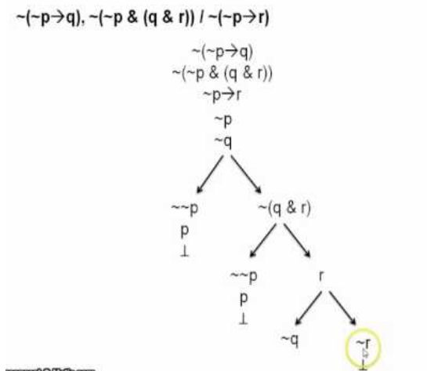
Applications
Automated reasoning has been most commonly used to build automated theorem provers.

Slide 40
Outline
What is AI?
The history of AI
Applications of AI
Current status of AI
The basic content of AI research
Cognitive modeling
Knowledge representation
Automatic reasoning
Machine learning
Future of AI

Slide 41
Machine learning
Machine Learning is the science of getting computers to learn and act like humans do, and improve their learning over time in autonomous fashion, by feeding them data and information in the form of observations and real-world interactions.

Slide 42
How is machine learning work ?
Tom Mitchell(1997): A computer program (vs human) is said to learn from experience E (e.g., labeled data ) with respect to some class of tasks T (e.g., classification) and performance measure P (e.g., precision & recall ), if its performance at tasks in T, as measured by P, improves with experience E.

Slide 43
Common learning tasks
Supervised learning: Given some example input output pairs , learn a function that maps from input to output.
Unsupervised learning: Final natural classes for examples.
Reinforcement learning: determine what to do based on a series of rewards or punishments.

Slide 44
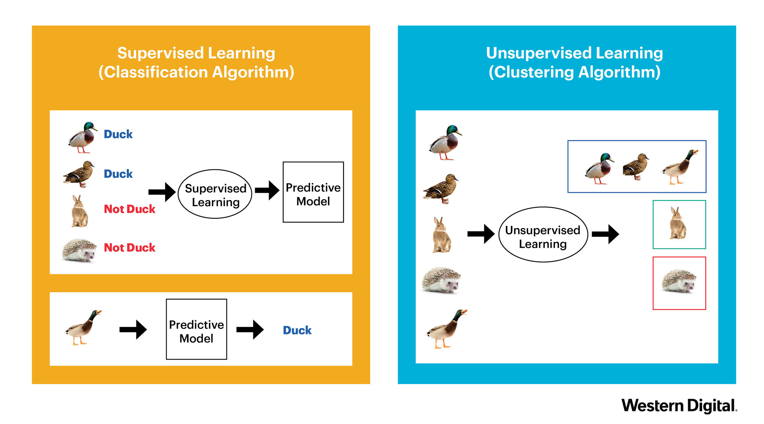
Supervised learning vs Unsupervised learning

Slide 45

Neural network
Back propagation
Nature
1986
Solve general learning problems
Tied with biological system

Slide 46
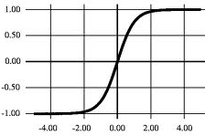
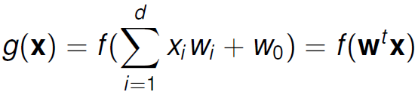
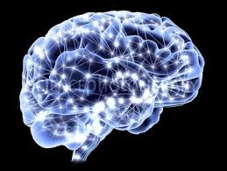
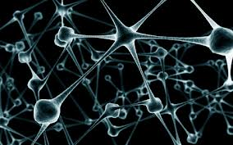
Neural network
Back propagation
Nature
1986
g(x)
w₁
w₂
w₃
x₁
x₂
x₃
f(net)

Slide 47
Neural network
Back propagation
Nature
1986
Solve general learning problems
Tied with biological system
But it is given up…
Hard to train
Insufficient computational resources
Small training sets
Does not work well

Slide 48
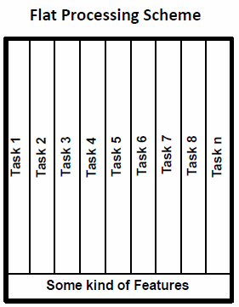
Neural network
Back propagation
Nature
1986
2006
SVM
Boosting
Decision tree
KNN
…
Flat structures
Loose tie with biological systems
Specific methods for specific tasks
Hand crafted features (GMM-HMM, SIFT, LBP, HOG)
Kruger et al. TPAMI’13

Slide 49
Neural network
Back propagation
Deep belief net
Science
Nature
1986
2006
…
…
Unsupervised & Layer-wised pre-training
Better designs for modeling and training (normalization, nonlinearity, dropout)
New development of computer architectures
GPU
Multi-core computer systems
Large scale databases
…
…
…
…
…
…

Slide 50
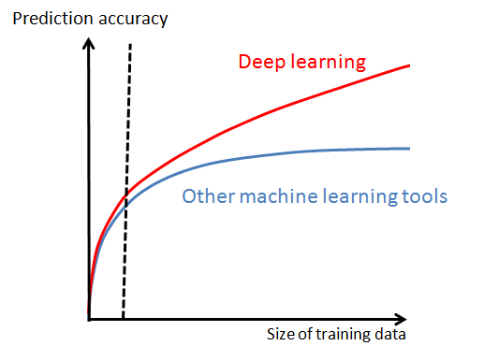
Machine Learning with Big Data
Machine learning with small data: overfitting, reducing model complexity (capacity)
Machine learning with big data: underfitting, increasing model complexity, optimization, computation resource
Notes:
大数据的出现对机器学习的影响。

Slide 51
How to increase model capacity?
Curse of dimensionality
Blessing of dimensionality
Learning hierarchical feature transforms
(Learning features with deep structures)
D. Chen, X. Cao, F. Wen, and J. Sun. Blessing of dimensionality: Highdimensional feature and its efficient compression for face verification. In Proc. IEEE Int’l Conf. Computer Vision and Pattern Recognition, 2013.
Notes:
大数据--维数载难—利用神经网络进行数据降维--利用深度模型对数据进行分层特征表达

Slide 52

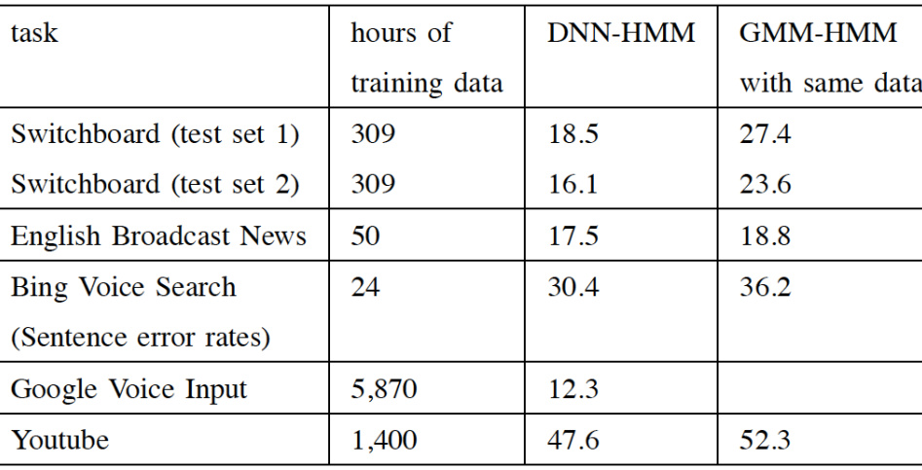

Neural network
Back propagation
Deep belief net
Science
Speech
Nature
1986
2006
2011
deep learning results
Solve general learning problems
Tied with biological system
But it is given up…

Slide 53
Neural network
Back propagation
Deep belief net
Science
Speech
Nature
1986
2006
2011
2012
Rank | Name | Error rate | Description
1 | U. Toronto | 0.15315 | Deep learning
2 | U. Tokyo | 0.26172 | Hand-crafted features and learning models. Bottleneck.
3 | U. Oxford | 0.26979
4 | Xerox/INRIA | 0.27058
Object recognition over 1,000,000 images and 1,000 categories (2 GPU)
A. Krizhevsky, L. Sutskever, and G. E. Hinton, “ImageNet Classification with Deep Convolutional Neural Networks,” NIPS, 2012.

Slide 54
Examples from ImageNet

Slide 55
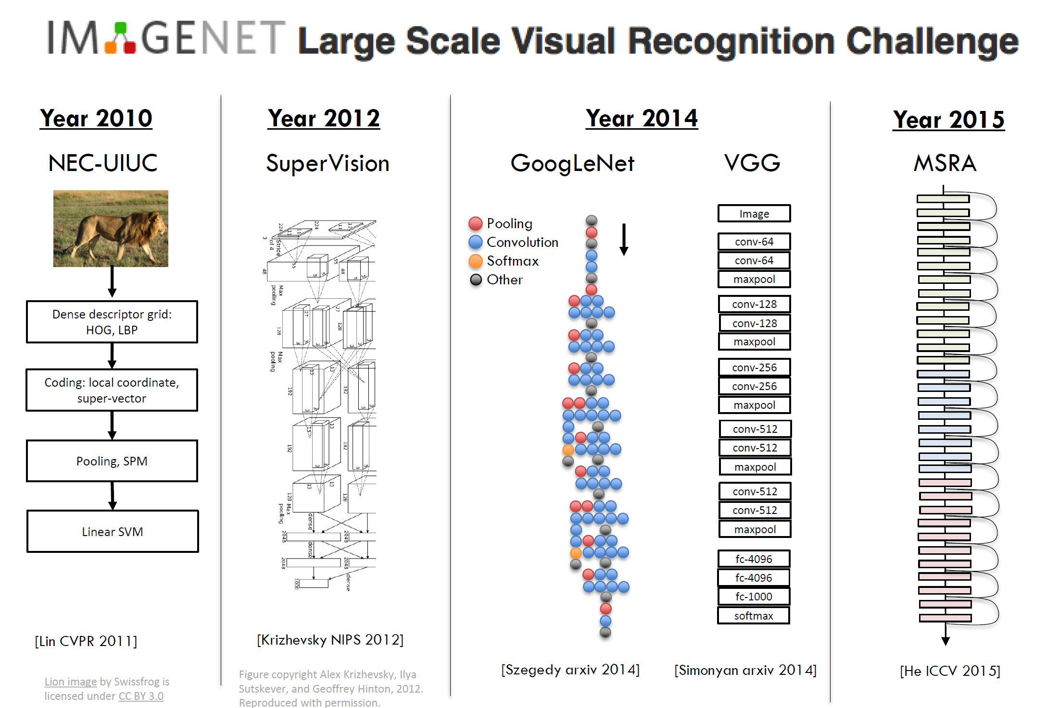

Slide 56
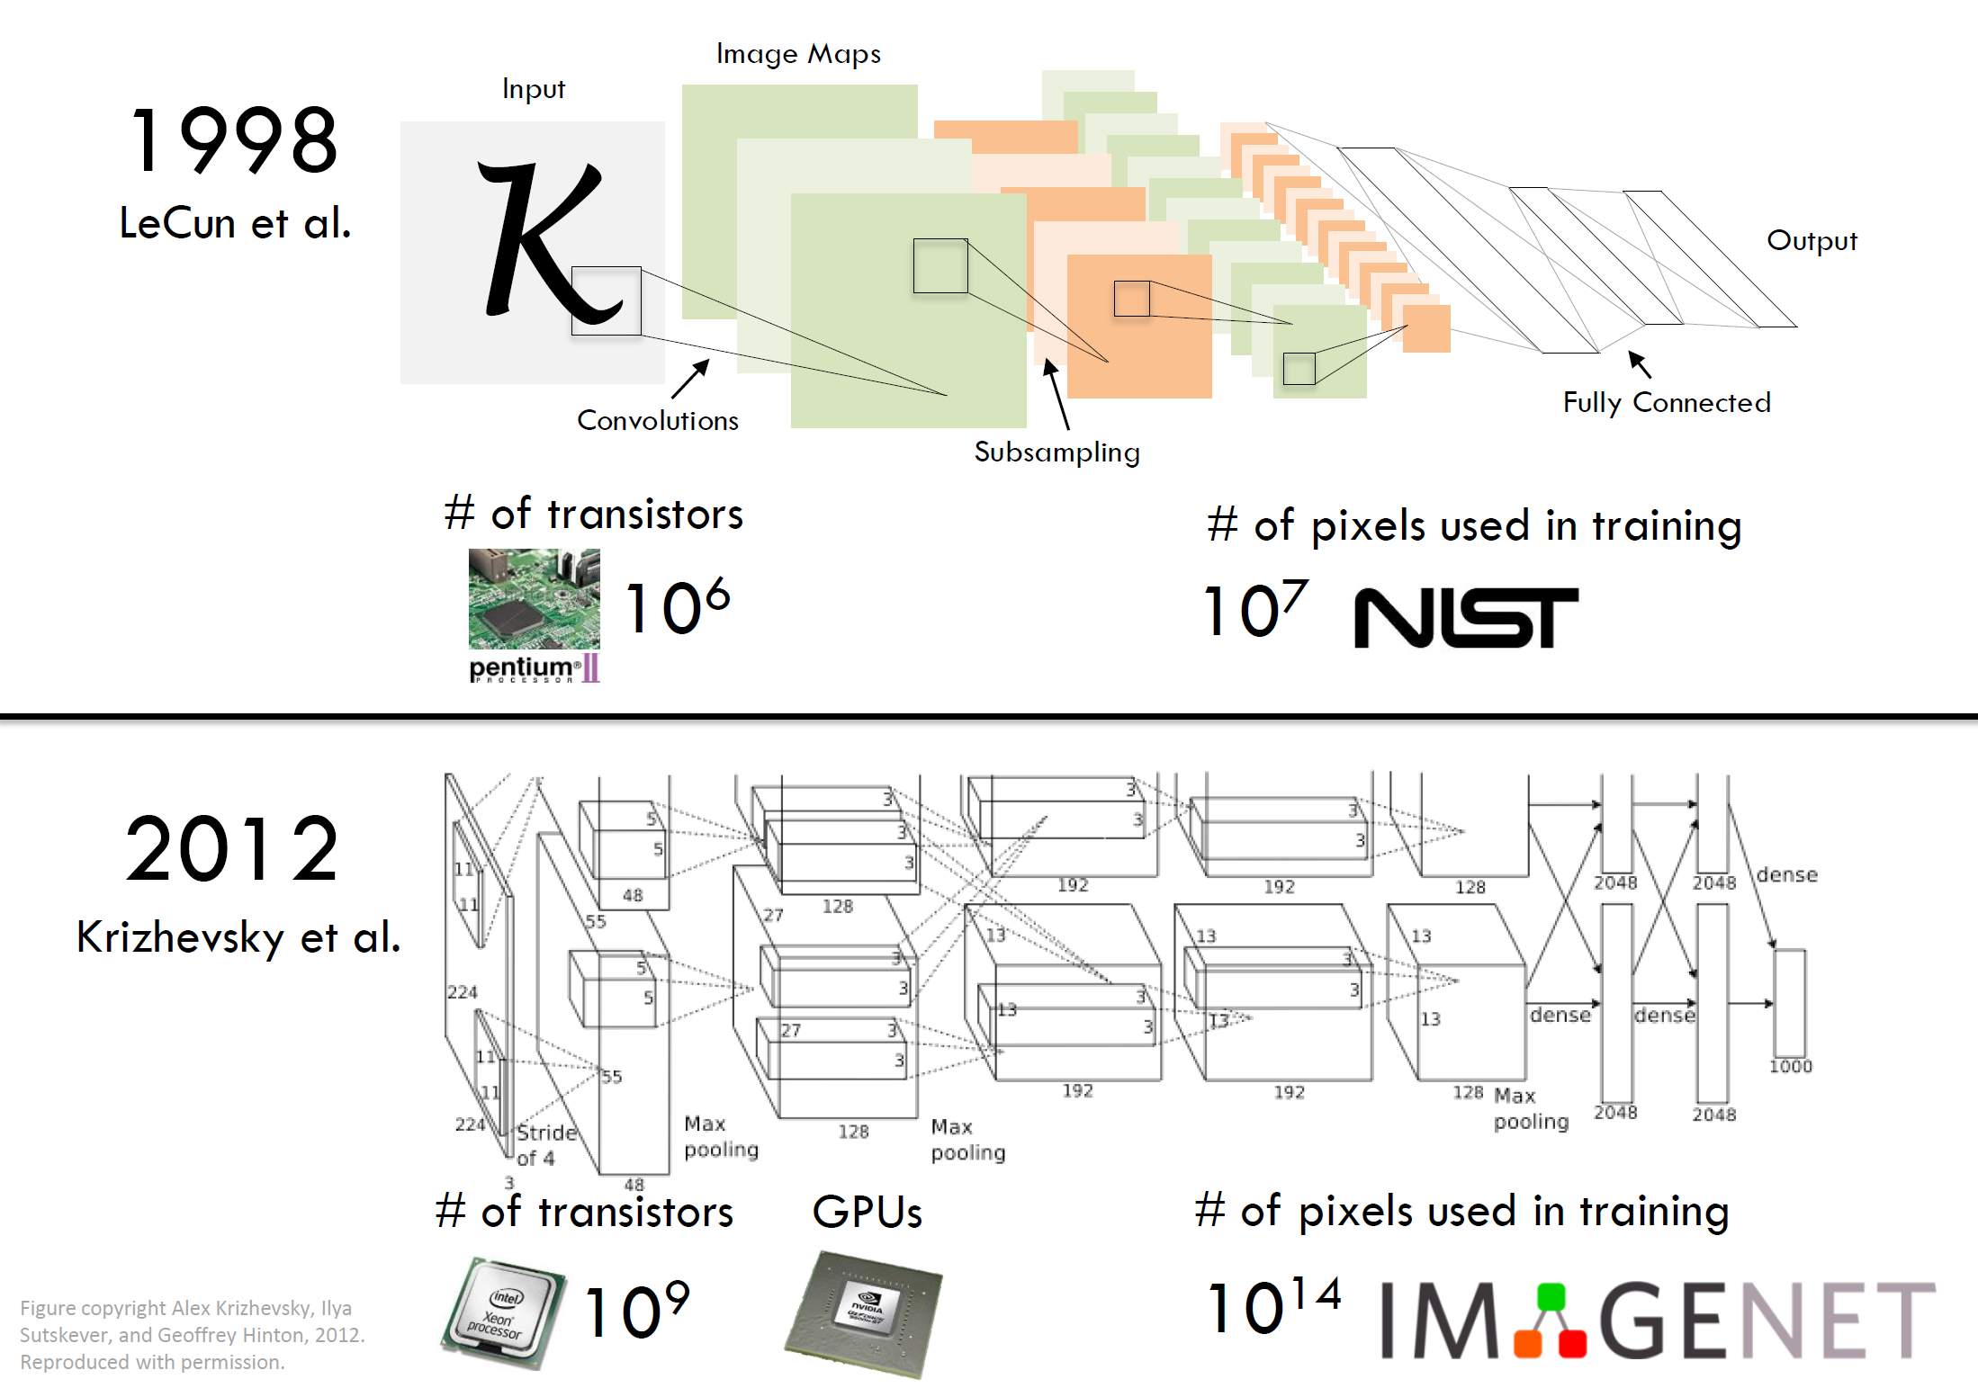

Slide 57
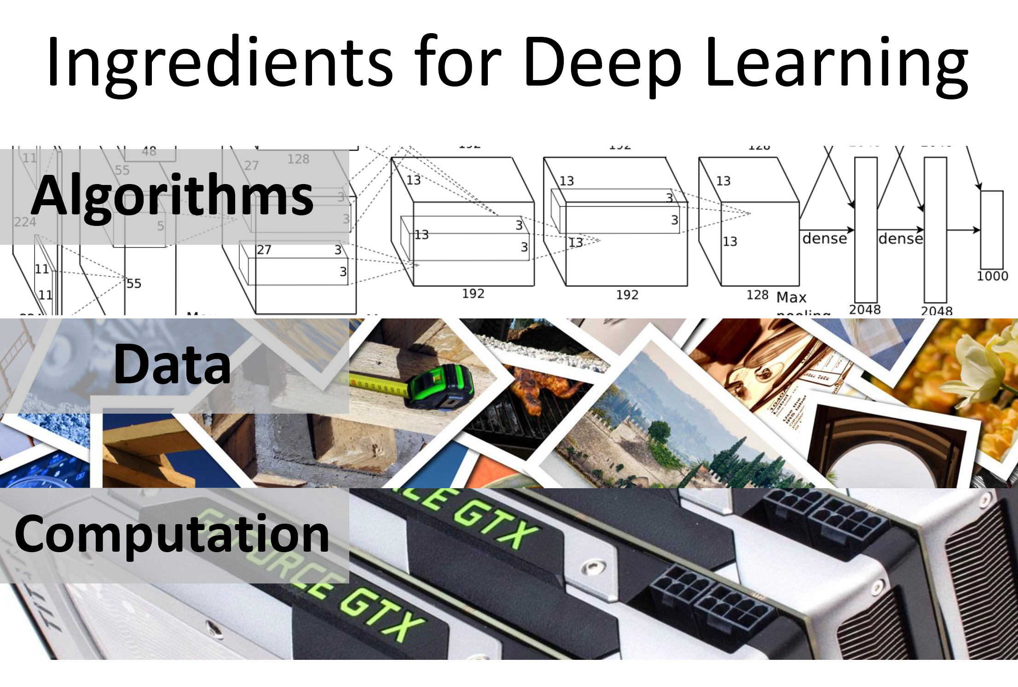

Slide 58
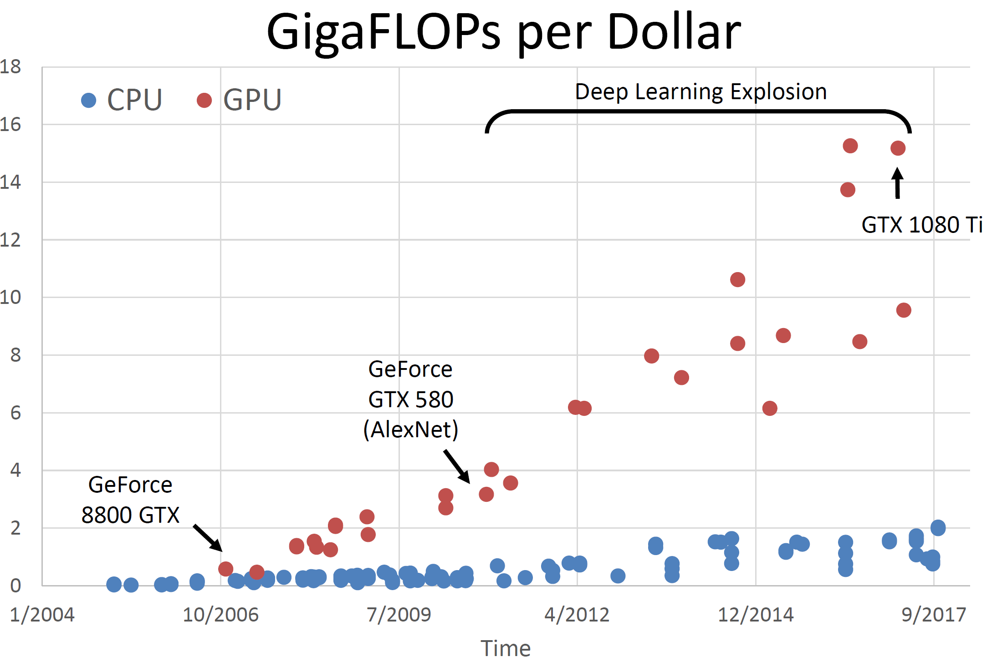

Slide 59
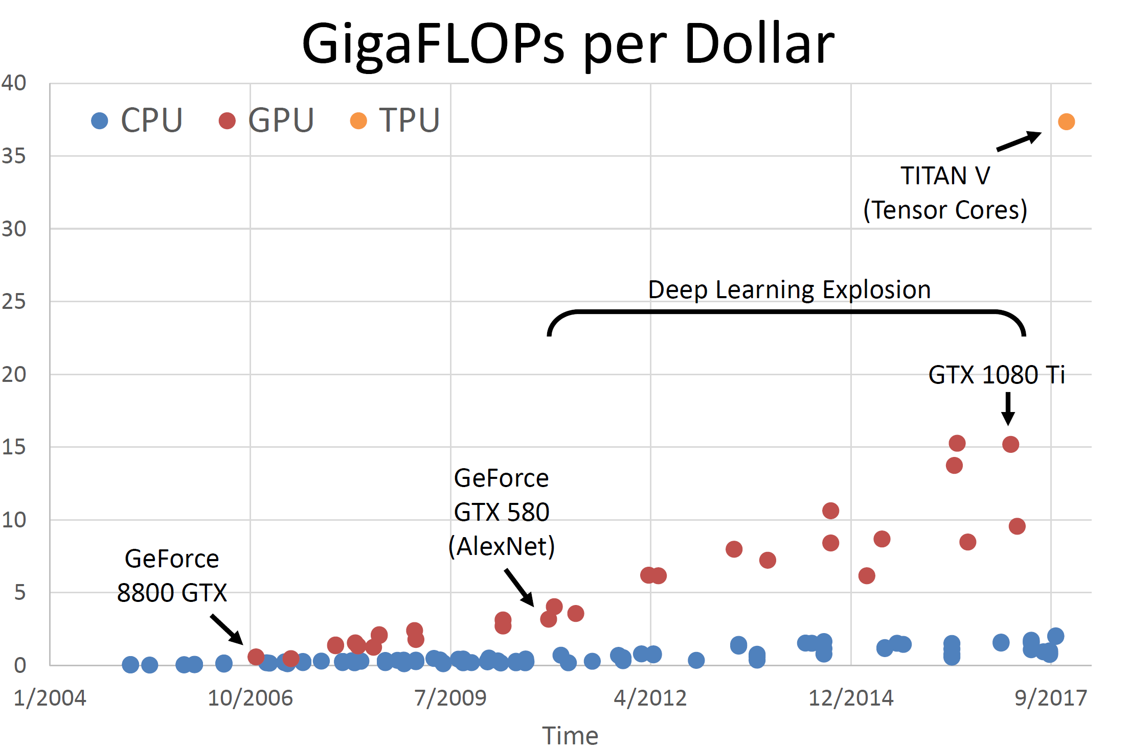

Slide 60
Neural network
Back propagation
Deep belief net
Science
Speech
1986
2006
2011
2012
ImageNet 2013 – image classification challenge
Rank | Name | Error rate | Description
1 | NYU | 0.11197 | Deep learning
2 | NUS | 0.12535 | Deep learning
3 | Oxford | 0.13555 | Deep learning
MSRA, IBM, Adobe, NEC, Clarifai, Berkley, U. Tokyo, UCLA, UIUC, Toronto …. Top 20 groups all used deep learning
ImageNet 2013 – object detection challenge
Rank | Name | Mean Average Precision | Description
1 | UvA-Euvision | 0.22581 | Hand-crafted features
2 | NEC-MU | 0.20895 | Hand-crafted features
3 | NYU | 0.19400 | Deep learning

Slide 61
Neural network
Back propagation
Deep belief net
Science
Speech
1986
2006
2011
2012
ImageNet 2014 – Image classification challenge
Rank | Name | Error rate | Description
1 | Google | 0.06656 | Deep learning
2 | Oxford | 0.07325 | Deep learning
3 | MSRA | 0.08062 | Deep learning
ImageNet 2014 – object detection challenge
Rank | Name | Mean Average Precision | Description
1 | Google | 0.43933 | Deep learning
2 | CUHK | 0.40656 | Deep learning
3 | DeepInsight | 0.40452 | Deep learning
4 | UvA-Euvision | 0.35421 | Deep learning
5 | Berkley Vision | 0.34521 | Deep learning

Slide 62
Neural network
Back propagation
Deep belief net
Science
Speech
1986
2006
2011
2012
ImageNet 2014 – object detection challenge
 | GoogleNet (Google） | DeepID‐Net (CUHK) | DeepInsight | UvA-Euvision | Berkley Vision | RCNN
Model average | 0.439 | 0.439 | 0.405 | n/a | n/a | n/a
Single model | 0.380 | 0.427 | 0.402 | 0.354 | 0.345 | 0.314
W. Ouyang et al. “DeepID‐Net: multi‐stage and deformable deep convolutional neural
networks for object detection”, arXiv:1409.3505, 2014

Slide 63


Neural network
Back propagation
Deep belief net
Science
Speech
1986
2006
2011
2012
Google and Baidu announced their deep learning based visual search engines (2013)
Google
“on our test set we saw double the average precision when compared to other approaches we had tried. We acquired the rights to the technology and went full speed ahead adapting it to run at large scale on Google’s computers. We took cutting edge research straight out of an academic research lab and launched it, in just a little over six months.”
Baidu
Notes:
在学术界收到广泛关注的同时，深度学习也在工业界产生了巨大的影响。谷歌，百度分别发布了自己的基于深度学习的视觉搜索引擎。

Slide 64
Neural network
Back propagation
Deep belief net
Science
Speech
Face recognition
1986
2006
2011
2012
2014
Deep learning achieves 99.47% face verification accuracy on Labeled Faces in the Wild (LFW), higher than human performance
Y. Sun, X. Wang, and X. Tang. Deep Learning Face Representation by Joint Identification-Verification. NIPS, 2014.
Y. Sun, X. Wang, and X. Tang. Deeply learned face representations are sparse, selective, and robust. arXiv:1412.1265, 2014.
Notes:
计算机视觉领域另一个重要的挑战是人脸识别。Labeled Faces in the Wild (LFW) 是当今最著名的人脸识别测试集，创建于2007 年。2014年，在这个测试集上，深度学习可以达到99.47%的识别率。

Slide 65

Common learning tasks
Reinforcement learning: determine what to do based on a series of rewards or punishments.

Slide 66
Examples
T Task E Labeled data P Measure
Checker (reinforcement learning):
T: playing checker
P: percent of games won against an opponent
E: playing practice games against itself
Handwriting recognition (supervised learning):
T: recognize handwritten words within images
P: percent of words correctly recognized
E: database of handwritten words with given classifications
Customer profiling (分析) (unsupervised learning):
T: cluster customers based on transaction patterns
P: homogeneity (同种性) of clusters
E: database of customer transactions

Slide 67
Outline
What is AI?
The history of AI
Applications of AI
Current status of AI
The basic content of AI research
Cognitive modeling
Knowledge representation
Automatic reasoning
Machine learning
Future of AI

Slide 68
Future of AI
AI’s hot spot:
Large-scale machine learning
Deep learning
Reinforce learning
Robotics
Computer vision
Natural Language Processing
Collaborative system（协作系统）
Crowdsourcing and human computation（众包与人机混合）
Algorithmic game theory and computational social choice（算法博弈论与计算机社会选择）
Internet of Thins（物联网）
Neuromorphic computing （神经形态计算）

Slide 69
Future of AI
AI is a promising industry with great potential and it can also benefit human by opening us up to the ability to be creative and to really think broadly because it can relieve us of many meaningless jobs.

Slide 70
Homework
Reading materials
浅谈人工智能：现状、任务、构架与统一, Song-Chun Zhu.
http://www.stat.ucla.edu/~sczhu/Blog_articles//浅谈人工智能.pdf

Slide 71
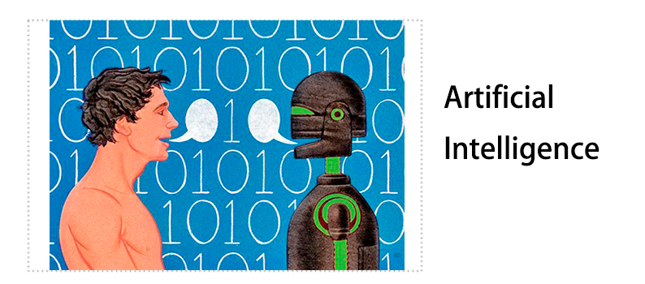
Thank you!

